Slide 1
Introduction
Case Study: PS Martek – A POS Market Place
• PSMartek, a PS market platform,
• wants to build Automated innovative online POS systems that cater to retail fashion stores
• aiming to handle 1K orders per Sec,
• capable of scaling to 50K transactions per sec within a year.
• PS would like to offer this to its clients as monetized services for its clients on a pay-as-you-go model.
• We should be able to onboard multiple clients/ stores as we scale up. This needs to be highly efficient.
• As a customer, you can scan a barcode and proceed with billing after trying the cloth of your choice.

Slide 2
Workflow
1. Enter the store
2. Download the app & Register / Login
3. Try different dresses
4. found fit, scan the QR / Barcode
5. checkout
6. payment
7. Order Summary
8. To be delivered to the delivery address
9. Walk out of the store carrying nothing.

Slide 3
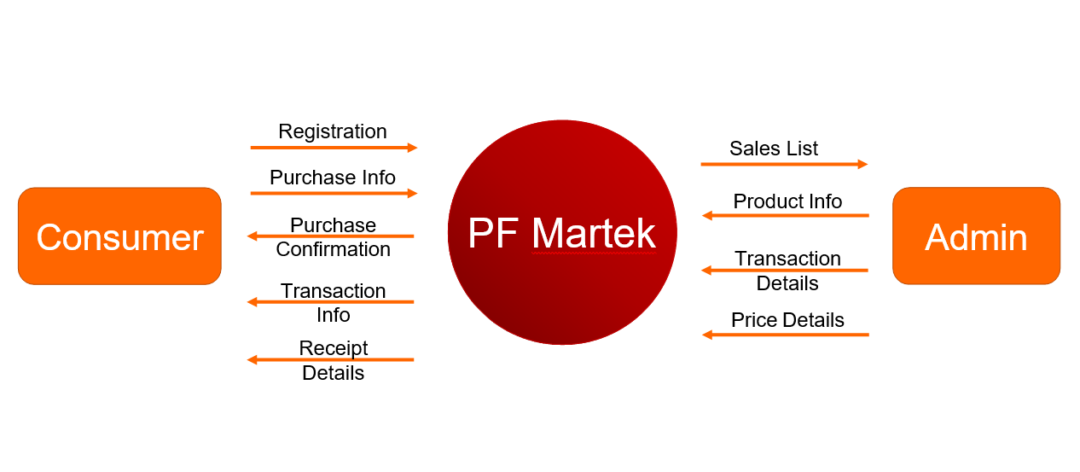
Level 0 Data Flow Diagram

Slide 4
Key Goals
Enable stores to onboard this automated solution and attract a more significant customer base while going automated, saving cost through the Pay-as-you-go model, and having a localized presence with a less in-store inventory.
Enable shoppers to have a consistent experience across its stores under similar brands.
Options for customers to install as an app and do self-billing within the store and checkout.
Software development is being awarded to you, but 3rd party provider will develop any hardware device, and the integration is out of this program's scope.
The POS system should have extensibility to ensure data sync with the online channel, enabling improved customer experience.

Slide 5
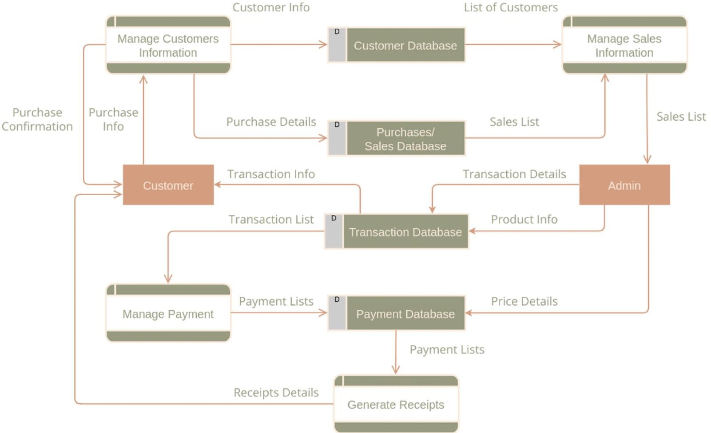

Slide 6
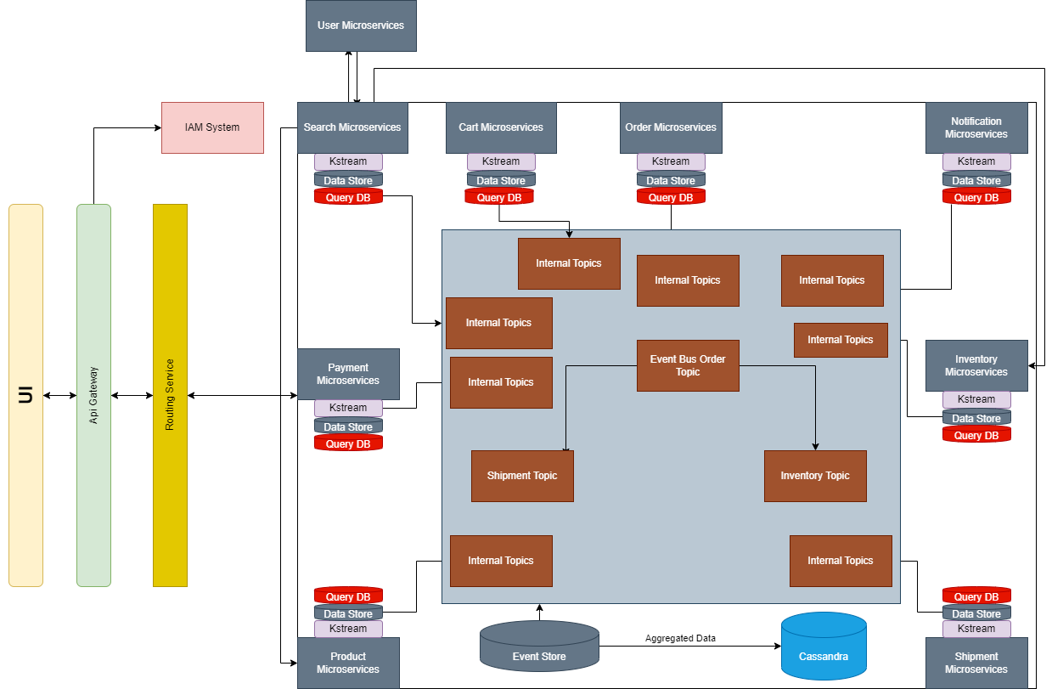
Architecture Diagram

Slide 7
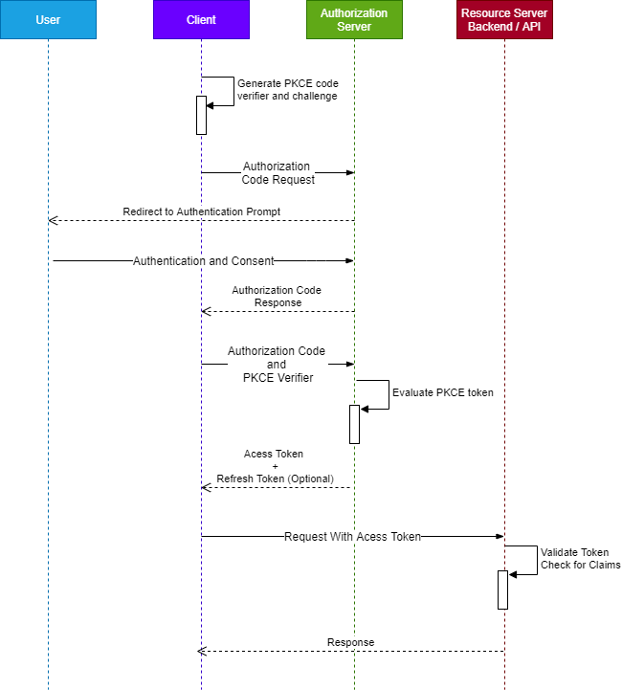
Sequence Flow of Auth0 for PCKE code grant

Slide 8
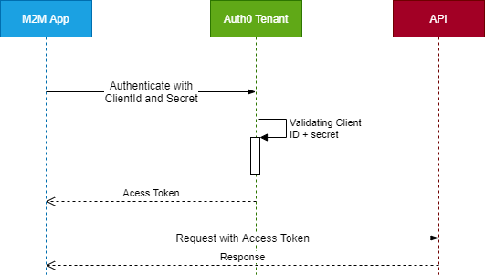
Sequence Diagram For Client Credentials Grant

Slide 9
Tech Stack
Java
Spring Boot
Kong Api Gateway
Auth 0
Kafka
Sonar
Cucumber
Rocks DB
Couch DB
Graph DB
Cassandra
Gradle
Microservices
ELK

